Slide 1
Pipelined Implementation

Slide 2
Outline
Instruction Stalling
Data Forwarding
Suggested Reading 4.5.6~4.5.8

Slide 3
Data Dependencies in Processors
1 irmovl $50, %eax
2 addl %eax , %ebx
3 mrmovl 100(%ebx),%edx
Result from one instruction used as operand for another
  Read-after-write (RAW) dependency
Very common in actual programs
Must make sure our pipeline handles these properly
  Get correct results
  Minimize performance impact
Notes:
相关性分为三种：先写后读、先读后写、两个写。
对于简单的PIPELINE来说，只有RAW是有问题的。
其他两种因为PIPELINE保证指令的先后顺序，所以在前面的仍然在前面，不会有问题。
原来的SEQ和SEQ+中不需要考虑这个问题。因为每条指令都是等前面的指令执行完后才进入CPU执行的，所以当他执行时所有前条产生的数据都已经有了。
而现在PIPE中，前条指令还没有执行完，后条就开始执行了，这样就可能要用到的前条产生的数据还没有产生。

Slide 4
Data Dependencies
1
2
3
4
5
6
7
8
F
F
D
D
E
E
M
M
W
W
F
F
D
D
E
E
M
M
W
W
F
F
D
D
E
E
M
M
W
W
F
F
D
D
E
E
M
M
W
W
# demo-h0.ys
0x000:irmovl $10,%edx
0x006:irmovl $3,%eax
0x00c:addl %edx,%eax
0x00e:halt
Cycle 4
Memory
M_valE=10
M_dstE=%edx
Execute
e_valE←0+3=3
E_dstE=%eax
•
•
Decode
val←R[%edx]=0
val←R[%eax]=0
Error

Slide 5
Data Dependencies: 3 Nop’s
1
2
3
4
5
6
7
8
9
10
11
F
F
D
D
E
E
M
M
W
W
F
F
D
D
E
E
M
M
W
W
F
F
D
D
E
E
M
M
W
W
F
F
D
D
E
E
M
M
W
W
F
F
D
D
E
E
M
M
W
W
# demo-h3.ys
0x000:irmovl $10,%edx
0x006:irmovl $3,%eax
0x00c:nop
0x00d:nop
0x00e:nop
0x00f:addl %edx,%eax
0x011:halt
F
F
D
D
E
E
M
M
W
W
F
F
D
D
E
E
M
M
W
W
Cycle 6
Write Back
R[%eax]←3
Cycle 7
Decode
val←R[%edx]=10
val←R[%eax]=3

Slide 6
Data Dependencies: 1 Nop
1
2
3
4
5
6
7
8
9
F
F
D
D
E
E
M
M
W
W
F
F
D
D
E
E
M
M
W
W
F
F
D
D
E
E
M
M
W
W
F
F
D
D
E
E
M
M
W
W
F
F
D
D
E
E
M
M
W
W
# demo-h1.ys
0x000:irmovl $10,%edx
0x006:irmovl $3,%eax
0x00c:nop
0x00d:addl %edx,%eax
0x00f:halt
Cycle 5
Write Back
R[%edx]←10
Memory
M_valE=3
M_dstE=%eax
•
•
Decode
val←R[%edx]=0
val←R[%eax]=0
Error

Slide 7
Data Dependencies: 2 Nop’s
1
2
3
4
5
6
7
8
9
10
11
# demo-h2.ys
0x000:irmovl $10,%edx
0x006:irmovl $3,%eax
0x00c:nop
0x00d:nop
bubble
0x00e:addl %edx,%eax
0x010:halt
F
D
E
M
W
F
D
E
M
W
F
D
E
M
W
F
D
E
M
W
E
M
W
F
D
D
E
M
W
F
F
D
E
M
W
If instruction follows too closely after one that writes register, slow it down
Hold instruction in decode
Dynamically inject nop into execute stage
Notes:
因为读和写寄存器都发生在Cycle 6的末尾，两者基本上同时发生，读稍微要早那么一点点，因为写有延迟。

Slide 8
Write back
dstE
W
icode
valE
valM
dstM
Mem
read
data out
.
Data Memory
Memory
control
write
M_Cnd
Addr
data in
M_valA
M
icode
Cnd
valE
valA
dstE
dstM
e_Cnd
CC
ALU
ALU fun
ALUA
ALUB
Execute
valC
srcA
E
icode
srcB
ifun
valA
valB
dstE
dstM
d_rvalA
d_srcA
d_srcB
Select A
srcA
dstM
srcB
dstE
A
B
Decode
M
W_valM
E
Register File
W_valE
D
icode
valC
valP
ifun
rA
rB
Predict PC
Instruction Memory
PC
Instruction
PC
increment
Fetch
f_PC
M_valA
Select PC
W_valM
F
predPC

Slide 9
Stall Condition
Source Registers
  srcA and srcB of current instruction in decode stage
Destination Registers
  dstE and dstM fields
  Instructions in execute, memory, and write-back stages
Condition
  srcA==dstE or srcA==dstM
  srcB==dstE or srcB==dstM
Special Case
  Don’t stall for register ID F
    Indicates absence of register operand

Slide 10
Data Dependencies: 2 Nop’s
1
2
3
4
5
6
7
8
9
10
11
F
D
E
M
W
F
D
E
M
W
F
D
E
M
W
F
D
E
M
W
E
M
W
# demo-h2.ys
0x000:irmovl $10,%edx
0x006:irmovl $3,%eax
0x00c:nop
0x00d:nop
bubble
0x00e:addl %edx,%eax
0x010:halt
F
D
D
E
M
W
F
F
D
E
M
W
Cycle 6
Write Back
W_dstE=%eax
W_valE=3
•
•
•
•
Decode
srcA=%edx
srcB=%eax
Notes:
因为读和写寄存器都发生在Cycle 6的末尾，两者基本上同时发生，读稍微要早那么一点点，因为写有延迟。

Slide 11
Stalling X3
1
2
3
4
5
6
7
8
9
10
11
F
D
E
M
W
F
D
E
M
W
# demo-h0.ys
0x000:irmovl $10,%edx
0x006:irmovl $3,%eax
bubble
bubble
bubble
0x00c:addl %edx,%eax
0x0e:halt
E
M
W
E
M
W
E
M
W
F
D
D
D
D
E
M
W
F
F
F
F
D
E
M
W
Cycle 6
Write Back
Cycle 5
W_dstE=%eax
Memory
•
•
•
•
Cycle 4
M_dstE=%eax
Execute
•
•
E_dstE=%eax
Decode
Decode
Decode
srcA=%edx
srcB=%eax
srcA=%edx
srcB=%eax
srcA=%edx
srcB=%eax

Slide 12
What Happens When Stalling?
# demo-h0.ys
Stalling instruction held back in decode stage
Following instruction stays in fetch stage
Bubbles injected into execute stage
  Like dynamically generated nop’s
  Move through later stages
0x000: irmovl $10,%edx
0x006: irmovl $3,%eax
0x00c: addl %edx,%eax
0x00e: halt
Cycle 8
Write Back
bubble
Memory
bubble
Execute
0x00c: addl %edx,%eax
Decode
0x00e: halt
Fetch

Slide 13
Implementing Stalling
W_
dstM
W_
dstE
W
icode
valE
valM
dstE
dstM
M_
dstM
M_
dstE
M
icode
Cnd
valE
valA
dstE
dstM
E_
dstM
Pipe
E_
dstE
control
E_bubble
logic
E
icode
ifun
valC
valA
valB
dstE
dstM
d_
srcB
d_
srcA
srcB
srcA
D_stall
D
icode
ifun
rA
rB
valC
valP
F_stall
F
predPC
Notes:
E M W三个阶段的dstM dstE和D阶段的srcA srcB比较，所以这几个信号必然都要进入Pipe control logic.
E_bubble，D_stall和F_stall作为该控制逻辑的输出，控制bubble和stall行为。

Slide 14
Implementing Stalling
Pipeline Control
  Combinational logic detects stall condition
  Sets mode signals for how pipeline registers should update
Notes:
E M W三个阶段的dstM dstE和D阶段的srcA srcB比较，所以这几个信号必然都要进入Pipe control logic.
E_bubble，D_stall和F_stall作为该控制逻辑的输出，控制bubble和stall行为。

Slide 15
Initial Version of Pipeline Control
bool F_stall =
d_srcA in {E_dstE, E_dstM, M_dstE, M_dstM,
W_dstE, W_dstM } ||
d_srcB in {E_dstE, E_dstM, M_dstE, M_dstM,
W_dstE, W_dstM };
bool D_stall =
d_srcA in {E_dstE, E_dstM, M_dstE, M_dstM,
W_dstE, W_dstM } ||
d_srcB in {E_dstE, E_dstM, M_dstE, M_dstM,
W_dstE, W_dstM };
bool E_bubble =
d_srcA in {E_dstE, E_dstM, M_dstE, M_dstM,
W_dstE, W_dstM } ||
d_srcB in {E_dstE, E_dstM, M_dstE, M_dstM,
W_dstE, W_dstM };

Slide 16
Pipeline Register Modes
Input = y
Output = x
Normal
x
x
stall
bubble
= 0
= 0
Rising
Rising

clock

Output = y
clock
y
y
Notes:
上图中的stall信号和bubble信号正是作用于这种特殊的寄存器才能起作用。
Bubble和stall同时为1是不允许的。

Slide 17
Pipeline Register Modes
Input = y
Output = x
Stall
x
x
stall
bubble
= 1
= 0
Rising
Rising

clock

Output = x
clock
x
x
Notes:
上图中的stall信号和bubble信号正是作用于这种特殊的寄存器才能起作用。
Bubble和stall同时为1是不允许的。

Slide 18
Pipeline Register Modes
Input = y
Output = x
Bubble
x
x
stall
bubble
= 0
= 1
Rising
Rising

clock

Output =
nop
clock
n
o
p
Notes:
上图中的stall信号和bubble信号正是作用于这种特殊的寄存器才能起作用。
Bubble和stall同时为1是不允许的。

Slide 19
Data Forwarding
Observation
  Value generated in execute or memory stage
Trick
  Pass value directly from generating instruction to decode stage
  Needs to be available at end of decode stage
Notes:
这个Naïve pipeline说的是PIPE-或者是使用stall技术的简单pipeline

Slide 20
Data Dependencies: 2 Nop’s
1
2
3
4
5
6
7
8
9
10
F
F
D
D
E
E
M
M
W
W
F
F
D
D
E
E
M
M
W
# demo-h2.ys
0x000:irmovl $10,%edx
0x006:irmovl $3,%eax
0x00c:nop
0x00d:nop
0x00e:addl %edx,%eax
0x010:halt
W
F
F
D
D
E
E
M
M
W
W
F
F
D
D
E
E
M
M
W
W
F
F
D
D
E
E
M
M
W
W
F
F
D
D
E
E
M
M
W
W
Cycle 6
Write Back
W_dstE=%eax
W_valE=3
R[%eax]←3
irmovl in W stage
Destination value in W pipeline register
Forward as valB for D stage
•
•
•
•
Decode
srcA=%edx
srcB=%eax
valA←R[%edx]=10
valB←W_valE=3
Notes:
因为读和写寄存器都发生在Cycle 6的末尾，两者基本上同时发生，读稍微要早那么一点点，因为写有延迟。

Slide 21
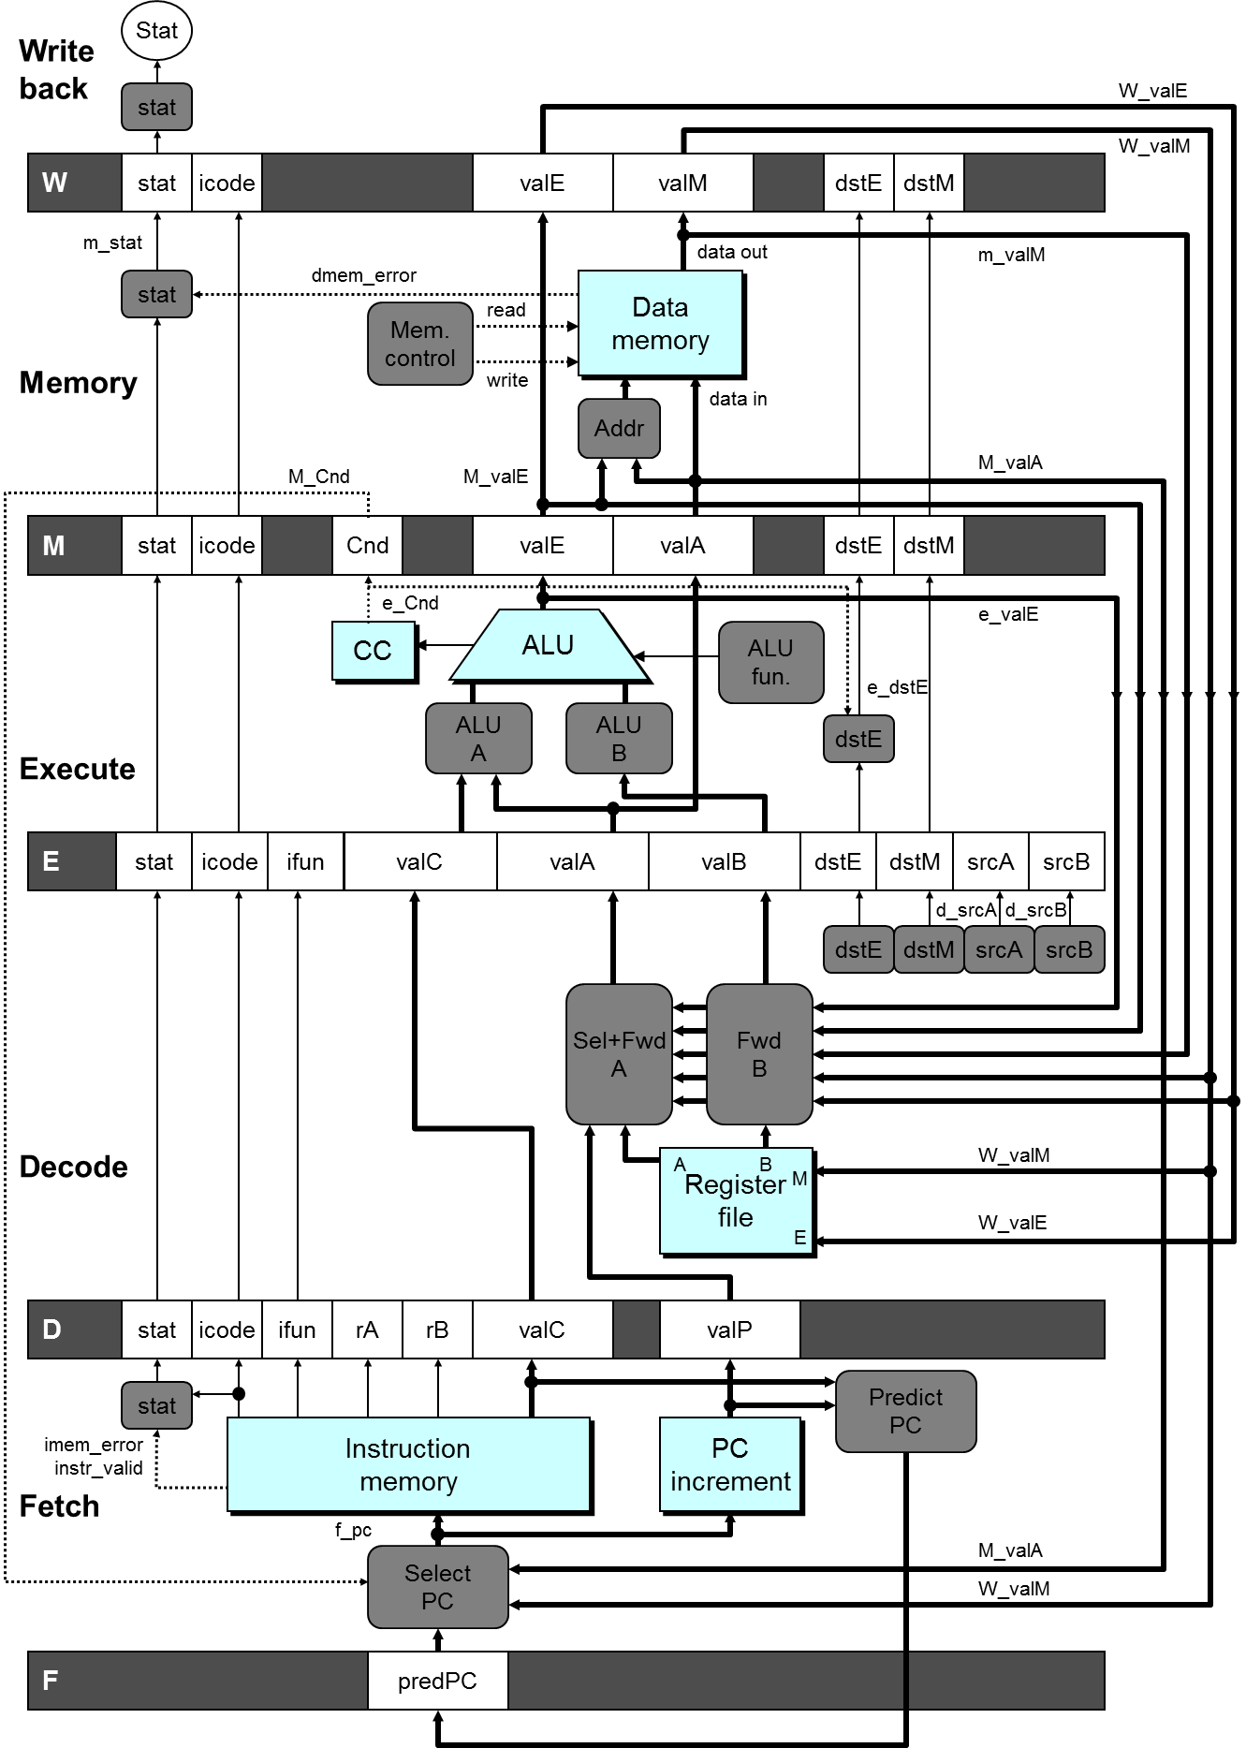

Slide 22
Bypass Paths
Decode Stage
  Forwarding logic selects valA and valB
  Normally from register file
  Forwarding: get valA or valB from later pipeline stage
Forwarding Sources
  Execute: valE
  Memory: valE, valM
  Write back: valE, valM

Slide 23
Data Dependencies: No Nop
1
2
3
4
5
6
7
8
F
F
D
D
E
E
M
M
W
W
F
F
D
D
E
E
M
M
W
# demo-h0.ys
0x000:irmovl $10,%edx
0x006:irmovl $3,%eax
0x00c:addl %edx,%eax
0x00e:halt
W
F
F
D
D
E
E
M
M
W
W
F
F
D
D
E
E
M
M
W
W
Cycle 4
Memory
M_valE=10
M_dstE=%edx
Register %edx
  Generated by ALU during previous cycle
  Forward from M stage as valA
Register %eax
  Value just generated by ALU
  Forward from E stage as valB
Execute
e_valE←0+3=3
E_dstE=%eax
•
•
Decode
srcA=%edx
srcB=%eax
val←M_valE=10
val←e_valE=3

Slide 24
Implementing Forwarding
Add additional feedback paths from E, M, and W pipeline registers into decode stage
Create logic blocks to select from multiple sources for valA and valB in decode stage
Notes:
因为原来valA是通过选择Select valP和srcA对应的值来的。现在srcA对应的值通过forward模块进行选择到底从那里得到。所以valA必须经过select和forward两个模块。所以简写为
Sel+Fwd A.

Slide 25
W_
valE
W_
valM
valE
valM
dstE
dstM
data out
m_
valM
Data
Data
memory
memory
data in
Addr
M_
valE
valE
valA
dstE
dstM
e_
ALU
valE
ALU
ALU
fun.
ALU
B
valA
valB
dstE
dstM
srcA
srcB
d_
srcA
d_
srcB
d_valA_
dstE
dstM
srcA
srcB
Sel
Fwd
+Fwd
A
B
W_
valM
A
M
B
Register
Register
W_
file
valE
file
E
Notes:
因为原来valA是通过选择Select valP和srcA对应的值来的。现在srcA对应的值通过forward模块进行选择到底从那里得到。所以valA必须经过select和forward两个模块。所以简写为
Sel+Fwd A.

Slide 26
Implementing Forwarding
## What should be the A value?
int d_valA = [
# Use incremented PC
D_icode in { ICALL, IJXX } : D_valP;
# Forward valE from execute
d_srcA == E_dstE : e_valE;
# Forward valM from memory
d_srcA == M_dstM : m_valM;
# Forward valE from memory
d_srcA == M_dstE : M_valE;
# Forward valM from write back
d_srcA == W_dstM : W_valM;
# Forward valE from write back
d_srcA == W_dstE : W_valE;
# Use value read from register file
1 : d_rvalA;
];
Notes:
注意：五个forward条件之间的顺序不能更换。
因为首先在pipeline中阶段越前的指令越靠近目标指令，所以如果两个不同阶段的指令写同一个寄存器，显然应该保留阶段较前的那个。
其次，同一阶段dstE可能和dstM相同，这发生在 popl %esp上。根据语义，%esp的内容应该是内存的值，而不是计算得到的值。

Slide 27
Limitation of Forwarding
1
2
3
4
5
6
7
8
9
10
11
#demo-luh.ys
0x000: irmovl $128, %edx
0x006: irmovl $3, %ecx
0x00c: rmmovl %ecx, 0(%edx)
0x012: irmovl $10, %ebx
#Load %eax
0x018: mrmovl 0(%edx), %eax
#Use %eax
0x10e: addl %ebx, %eax
0x020: halt
Load-use dependency
  Value needed by end of
  D stage in cycle 7
  Value read from memory
  in M stage of cycle 8
F
D
E
M
W
F
D
E
M
W
F
D
E
M
W
F
D
E
M
W
F
F
D
D
E
E
M
M
W
W
F
D
E
M
W
F
D
E
M
W
Cycle 7
Cycle 8
Memory
Memory
M_dstE=%ebx
M_valE=10
M_dstM=%eax
m_valM ← M[128]=3
•
•
Decode
valA←M_valM=10
valB←R[%eax]=0
Error
Notes:
Forward可以解决大部分data dependence问题。对于上面的load/use问题，虽然他属于我们已经给出的五种forward数据的来源之一（寄存器的结果来自于内存），应该用forward技术。但因为memory来得太晚，所以addl指令必须要stall才能正确。
推广开来，如果产生数据的源和目的之间的最小stage>1，那么就必须stall。dstE之所以不引起stall是因为dstE的值由execute stage产生，要使用它的是decode stage。两者之间的stage差为1。

Slide 28
Avoiding Load/Use Hazard
1
2
3
4
5
6
7
8
9
10
11
12
F
F
D
D
E
E
M
M
W
W
#demo-luh.ys
0x000: irmovl $128, %edx
0x006: irmovl $3, %ecx
0x00c: rmmovl %ecx, 0(%edx)
0x012: irmovl $10, %ebx
#Load %eax
0x018: mrmovl 0(%edx), %eax
#Use %eax
0x10e: addl %ebx, %eax
0x020: halt
Stall using instruction for one cycle
Can then pick up loaded value by forwarding from memory
F
F
D
D
E
E
M
M
W
W
F
F
D
D
E
E
M
M
W
W
F
F
D
D
E
E
M
M
W
W
F
F
F
D
D
D
E
E
E
M
M
M
W
W
W
E
M
W
F
D
D
E
M
W
F
F
D
E
M
W
Cycle 8
Write Back
W_dstE=%ebx
W_valE=10
Memory
M_dstM=%eax
m_valM ← M[128]=3
•
Decode
valA←W_valM=10
valB←m_valM=3

Slide 29
Detecting Load/Use Hazard
Condition | Trigger
Load/Use Hazard | E_icode in { IMRMOVL, IPOPL } && E_dstM in { d_srcA, d_srcB }
e_Bch
e_
ALU
ALU
valE
CC
ALU
CC
fun.
ALU
ALU
Execute
A
B
E
icode
ifun
valC
valA
valB
dstE
dstM
srcA
srcB
d_
srcA
d_
srcB
dstE
dstM
srcA
srcB
Sel
Fwd
+Fwd
A
B
W_
Decode
valM
A
M
B
Register
Register
W_
file
valE
file
E
D
icode
ifun
rA
rB
valC
valP

Slide 30
Control for Load/Use Hazard
1
2
3
4
5
6
7
8
9
10
11
12
F
F
D
D
E
E
M
M
W
W
#demo-luh.ys
0x000: irmovl $128, %edx
0x006: irmovl $3, %ecx
0x00c: rmmovl %ecx, 0(%edx)
0x012: irmovl $10, %ebx
#Load %eax
0x018: mrmovl 0(%edx), %eax
#Use %eax
0x10e: addl %ebx, %eax
0x020: halt
Stall instructions in fetch and decode stages
Inject bubble into execute stage
F
F
D
D
E
E
M
M
W
W
F
F
D
D
E
E
M
M
W
W
F
F
D
D
E
E
M
M
W
W
F
F
F
D
D
D
E
E
E
M
M
M
W
W
W
E
M
W
F
D
D
E
M
W
F
F
D
E
M
W
Condition | F | D | E | M | W
Load/Use Hazard | stall | stall | bubble | normal | normal
Notes:
在最后一个stall之后，必须有一个bubble，不然原来的指令还是会被组合电路传递到下一个阶段去，这样一条指令就执行了两次。

Slide 31
W
icode
valE
valM
dstE
dstM
M
icode
Cnd
valE
valA
dstE
dstM
E_
dstM
E_
icode
Pipe
E_bubble
E
icode
ifun
valC
valA
valB
dstE
control
dstM
d_
logic
srcB
d_
srcA
srcB
srcA
D_stall
D
icode
ifun
rA
rB
valC
valP
F_stall
F
predPC

